Slide 1
What should be our Investment Strategy for Mobile Apps
Informed by the analysis of
Google Play Store Apps Dataset
This presentation is meant to address co-founders of a new mobile app investment company, which profits from buying, marketing, optimizing and then selling mobile apps that have the potential to succeed.

Slide 2

Google Play Store App Dataset Overview, Market Landscape
The dataset: 9660 unique apps (ttl.2.56 m. available at the store)
93% are free apps
31 categories

Slide 3
The Utmost Indicator of Success: Number of INSTALLS
Direct link to revenue
Important factor in new adoption
Recommendation Algorithm
Users tend to follow the crowd

Slide 4
2nd in size, 1st in proportion of hit apps GAME: Most promising field
Under 5M installs
5M installs
10M installs
50M installs
Photography also has a high proportion of successful apps

Slide 5
Using same criteria, pick these genres Action, Arcade, Racing, Puzzle
Under 5M installs
5M installs
10M installs
50M installs

Slide 6

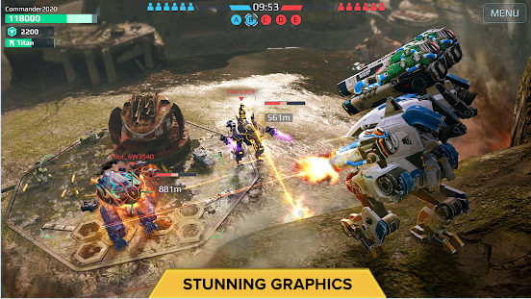
Do Hit Games Have to Be LARGE in Size (and Costly)?
War Robots 6v6 (Action)
50M+ Installs, 742MB

Slide 7

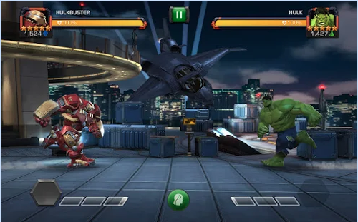
Do Hit Games Have to Be LARGE in Size (and Costly)?
Marvel: Contest of Champions (Action)
100M+ Installs, 71MB

Slide 8
Do Hit Games Have to Be LARGE in Size? Not Necessarily
App Size (Mb)

Slide 9

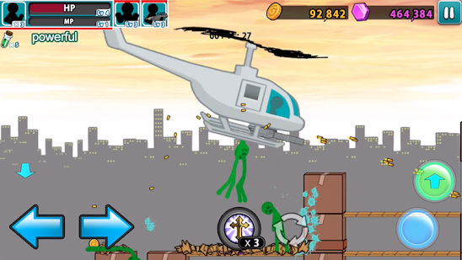
Light-weighted, Sketchy Graphic, but ADDICTIVE
Anger of Stick 5: Zombie(Action)
100M+ Installs, 27MB

Slide 10
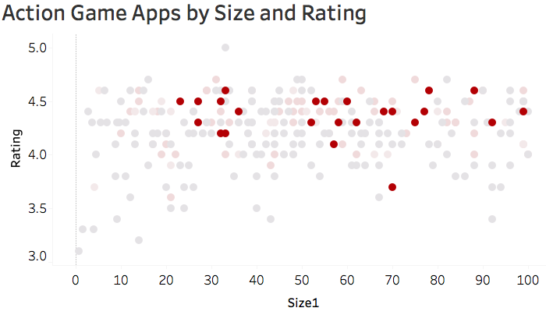
For Action Games with 50M+ installs Rating Range: 4.2~4.6
App Size (Mb)

Slide 11
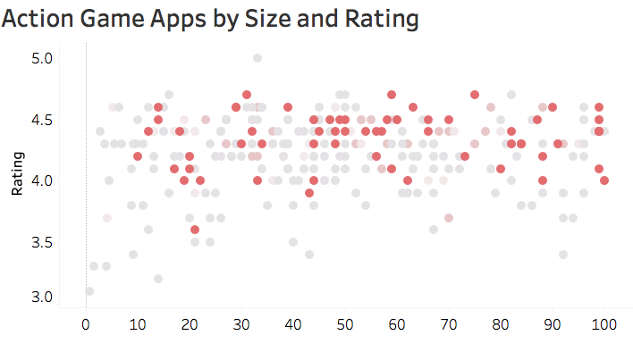
For Action Games with 10M+ installs Rating Range: 4.0~4.7
App Size (Mb)

Slide 12
Based on Rating, No. of Reviews and Size Picking the Next Killer Apps

Slide 13
Summary
And Thank you

